Slide 1
Indian Institute of Technology, Kharagpur
Case Study Presentation
on
W.W. Grainger and McMaster-Carr MRO Supplier
Guided by- Presented by –
Prof. S.P. Sarmah Mr. Ankit Patel (21IM60R22)
(Dept. of Industrial and Systems Engg.) Mr. Thiruchitrabalam (21IM60S01)
Mr. Santanu Banerjee (21IM72P01)
Mr. Amit Kumar Singh (21IM92R01)
Mr. Pranav Sanjay Gore (21ME63R27)
Department of Industrial and System Engineering

Slide 2

Contents
Introduction
Solo Taxonomy
Major Supply Chain Components
Major Supply Performance Drivers
Challenges in Supply Chain Management
How the firms addressed these supply chain challenges ?
Inventory management by Apt Design of the Distribution Network
Selecting the Distribution in Network design
Implementing CPFR Model
Managerial levers to increase profitability
Tailored Transportation
Case study questions and answers
Suggestions for the firm to tackle supply challenges
Green Supply Chain and how MRO giants can cool Earth ?
Integrating the Third dimension within Supply Chain classification

Slide 3
Introduction
W. W. Grainger company was founded by William Wallace Grainger in 1927 in Chicago, Illinois. W. W. Grainger, Inc. is a Fortune 500 industrial supply company founded in 1927 in Chicago. Revenue is generally from business-to-business sales rather than retail sales. Specializing in next day delivery of Maintenance, Repair and Operations (MRO) materials and supplies.
McMaster-Carr Supply Company is a private, family-owned supplier to industrial and commercial facilities worldwide. McMaster maintains over 5,55,000 products in a catalogue offering a variety of mechanical, electrical, plumbing, and utility hardware not usually located from a single source. The company is based in Elmhurst, Illinois.

Slide 4
W.W. Grainger | McMaster-Carr
Several retail stores throughout US Customer can walk into the store Call in order Place an order through web/online They either ship to the customer or picked by the customer at store | Concentrated on online Lack of retail stores Ships almost all orders

Slide 5
Solo Taxonomy
Pre Structural
Uni-Structural
Multi-Structural
Relational
Out of Box

Slide 6
Major Supply Chain Components
Information Management
Procurement of Supplies
(After) Sales and Customer Service Management for improving churn
Logistic Management
Customers
Store Planning for deep distribution

Slide 7
Major Supply Performance Drivers
Inventory
Transportation
Distribution & Variety
Facilities
W.W. Grainger makes itself efficient by stocking large amount of inventory and satisfying customers demands from stocks even though high inventory level develops another dimension of inventory management thereby increasing holding costs.
McMaster-Carr and W.W. Grainger, have structured their supply chain to provide service to most of their customer using ground transportation.
W.W. Grainger stocks about 2,00,000 SKUs that can be sent to the customer within a day of order placement.
Facilities are the actual physical locations in the supply chain network where product is stored, assembled, or fabricated.

Slide 8
Major Supply Performance Drivers
Information
Sourcing
Pricing
Information consists of data and analysis concerning facilities, inventory, transportation, costs, prices, and customers throughout the supply chain.
Sourcing is the choice of who will perform a particular supply chain activity, such as production, storage, transportation, or the management of information.
Pricing determines how much a firm will charge for the goods and services that it makes available in the supply chain.

Slide 9
Challenges in Supply Chain Management
Inventory management approximately 400000 SKU’s
Consumer Demands Drive Need for Improved Speed, Quality and Service
Supply Chain Complexity Due to Multiple Channels to Market
Increased Costs Throughout the Supply Chain
Desired Customer Service level maintenance
Notes:
Inventory management – What and how much to be stored at Manufacturing , Supplier , Distributor , and Retailer
Increased costs due to commodity cost increase , fuel costs ,
Desired customer service level – Trade off between costs and customer service level
Supply chain complexity – Orders placed at retailers , online , from distributor ; so the

Slide 10
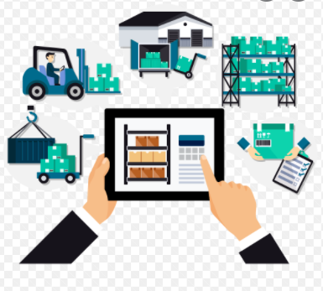

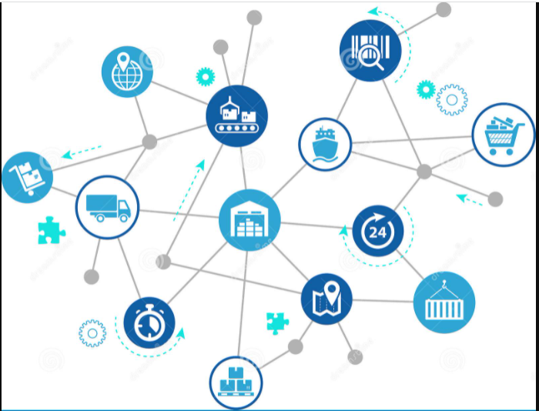
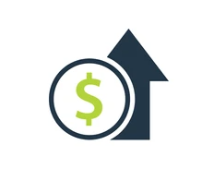
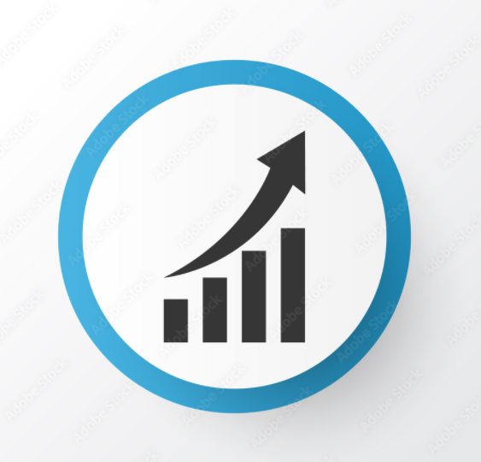
How the firms addressed these supply chain challenges ?
Inventory management
Apt design of the Distribution network
Improved forecasting and planning
Desired customer service level maintenance
Tailored transportation
Aggregation with Capacity constraint
Supply chain complexity
Computer assisted Ordering
Integrating POS, Online orders and other sites
Increased costs
Enhanced quality & service
Applying managerial lever to increase profitability
Local presence
Collaborative forecasting and planning

Slide 11

Inventory management by Apt Design of the Distribution Network
Manufacturer Storage with Direct Shipping
Manufacturer storage with direct shipping and in-transit merge
Distributor storage with carrier delivery
Manufacturer/distributor storage with customer pickup
Distributor storage with last-mile delivery
Retail storage with customer pickup

Slide 12
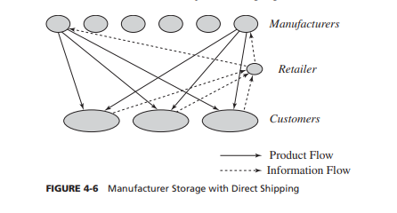
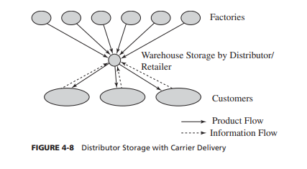
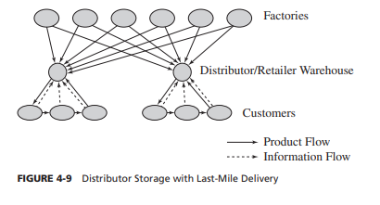
Inventory management by Apt Design of the Distribution Network
Manufacturer Storage with Direct Shipping
Centralizes inventory at manufacturer.
Aggregates demand across all retailers.
Distributor Storage with Carrier Delivery
Inventory is held not at manufacturers’ but at distributor end.
Package carriers are used to transport products.
Distributor storage with Last-mile Delivery
They stock only the slow- to fast-moving items at their warehouses.
Very slow-moving items stocked farther upstream.
Notes:
Manufacturer storage with drop shipping allows a high level of product variety to be available to the customer. With a drop-shipping model, every product at the manufacturer can be made available to the customer without any limits imposed by shelf space. W.W. Grainger is able to offer hundreds of thousands of slow-moving items from thousands of manufacturers using drop-shipping. This would be impossible if each product had to be stored by W.W. Grainger. Drop-shipping allows a new product to be available to the market the day the first unit is produced. Drop-shipping provides a good customer experience in the form of delivery to the customer location. The experience, however, suffers when a single order containing products from several manufacturers is delivered in partial shipments.
Distributor Storage with Carrier Delivery
Under this option, inventory is not held by manufacturers at the factories but is held by distributors/retailers in intermediate warehouses, and package carriers are used to transport products from the intermediate location to the final customer. Amazon and industrial distributors such as W.W. Grainger and McMaster-Carr have used this approach combined with drop-shipping from a manufacturer (or distributor). Information and product flows when using distributor storage with delivery by a package carrier are shown in Figure 4-8. Relative to manufacturer storage, distributor storage requires a higher level of inventory because of a loss of aggregation. From an inventory perspective, distributor storage makes sense for products with somewhat higher demand. This is seen in the operations of both Amazon and W.W. Grainger. They stock only the slow- to fast-moving items at their warehouses, with very slow-moving items stocked farther upstream. In some instances, postponement of product differentiation can be implemented with distributor storage, but it does require that the warehouse develop some assembly capability. Distributor storage, however, requires much less
Distributor storage with last-mile delivery requires higher levels of inventory than the other options (except for retail stores) because it has a lower level of aggregation. From an inventory perspective, warehouse storage with last-mile delivery is suitable for relatively fast-moving items that are needed quickly and for which some level of aggregation is beneficial. Auto parts required by car dealers fit this description. Among all the distribution networks, transportation costs are highest for last-mile delivery, especially when delivering to individuals. This is because package carriers aggregate delivery across many retailers and are able to obtain better economies of scale than are available to a distributor/retailer attempting last-mile delivery. Delivery costs (including transportation and processing) can be more than $20 per home delivery in the grocery industry. Last-mile delivery may be somewhat less expensive in large, dense cities. Transportation costs may also be justifiable for bulky products for which the customer is willing to pay for home delivery. Home delivery of water and large bags of rice has proved quite successful in China, where the high population density has helped decrease delivery costs. Transportation costs of last-mile delivery are best justified in settings where the customer is purchasing in large quantities. This is rare for individual customers, but businesses such as auto dealerships purchase large quantities of spare parts on a daily basis and can thus justify daily delivery. Home delivery to individual customers can be justified for bulky items such as five-gallon jugs of water in the United States and large bags of rice in China. In each instance, last-mile delivery is cheaper and more convenient than customers picking up their own bottles or bags. Using this option, facility costs are somewhat lower than for a network with retail stores but much higher than for either manufacturer storage or distributor storage with package carrier delivery. Processing costs, however, are much higher than for a network of retail stores because all customer participation is eliminated.

Slide 13
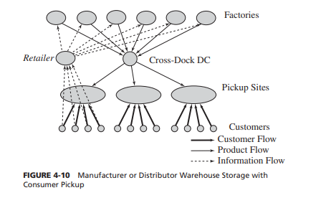
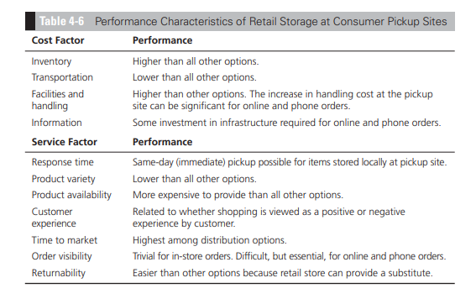
Inventory management by Apt Design of the Distribution Network
Manufacturer or Distributor Storage with Customer Pickup
Inventory is maintained at Manufacturing, Distributor and Warehouse.
Retail Storage with Customer Pickup
Package carriers are used to transport products from the intermediate location to the final customer.
Grainger keeps its inventory of fast-moving items at pickup locations.
Good response time can be achieved through this.
Slow-moving items are stocked at a central warehouse or in some cases at the manufacturer.
Inventory is held not at manufacturers’ but at distributor end.
Notes:
Manufacturer or Distributor Storage with Customer Pickup
Inventory costs using this approach can be kept low, with either manufacturer or distributor storage to exploit aggregation. W.W. Grainger keeps its inventory of fast-moving items at pickup locations, whereas slow-moving items are stocked at a central warehouse or in some cases at the manufacturer.
Facility costs are high if new pickup sites have to be built. A solution using existing sites can lower the additional facility costs. This, for example, is the case with 7dream.com, Wal-Mart, and W.W. Grainger, for which the stores already exist. Processing costs at the manufacturer or the warehouse are comparable to those of other solutions. Processing costs at the pickup site are high because each order must be matched with a specific customer when he or she arrives. Creating this capability can increase processing costs significantly if appropriate storage and information systems are not provided. Increased processing cost and potential errors at the pickup site are the biggest hurdle to the success of this approach. A significant information infrastructure is needed to provide visibility of the order until the customer picks it up. Good coordination is needed among the retailer, the storage location, and the pickup location
Retail Storage with Customer Pickup
In this option, often viewed as the most traditional type of supply chain, inventory is stored locally at retail stores. Customers walk into the retail store or place an order online or by phone and pick it up at the retail store. Examples of companies that offer multiple options of order placement include Albertsons, which uses part of the facility as a grocery store and part as an online fulfillment center. Customers can walk into the store or order online. A B2B example is Table 4-5 Performance Characteristics of Network with Consumer Pickup Sites Cost Factor Performance Inventory Can match any other option, depending on the location of inventory. Transportation Lower than the use of package carriers, especially if using an existing delivery network. Facilities and handling Facility costs can be high if new facilities have to be built. Costs are lower if existing facilities are used. The increase in handling cost at the pickup site can be significant. Information Significant investment in infrastructure required Service Factor Performance Response time Similar to package carrier delivery with manufacturer or distributor storage. Same-day delivery possible for items stored locally at pickup site. Product variety Similar to other manufacturer or distributor storage options. Product availability Similar to other manufacturer or distributor storage options. Customer experience Lower than other options because of the lack of home delivery. Experience is sensitive to capability of pickup location. Time to market Similar to manufacturer storage options. Order visibility Difficult but essential. Returnability Somewhat easier given that pickup location can handle returns. W.W. Grainger: Customers can order online, by phone, or in person and pick up their order at one of W.W. Grainger’s retail outlets. Albertsons keeps its inventory at the pickup location itself; W.W. Grainger stores some items at the pickup locations, whereas others may come from a central location. Local storage increases inventory costs because of the lack of aggregation. For fast- to very fast-moving items, however, there is marginal increase in inventory even with local storage. Albertsons uses local storage because most of its products are relatively fast moving and are stocked at the supermarket in any case. Similarly, W.W. Grainger keeps its inventory of fast-moving items at pickup locations, whereas slow-moving items are stocked at a central warehouse.
Good response times can be achieved with this system because of local storage. For example, both Albertsons and W.W. Grainger offer same-day pickup from their retail locations. Product variety stored locally is lower than under other options. It is more expensive than with all other options to provide a high level of product availability. Customer experience depends on whether or not the customer likes to shop.

Slide 14

Selecting the Distribution in Network design
Product characteristics as well as network requirements to be considered.
Different networks have different strengths and weaknesses.
To be tailored to match the characteristics of the product and the needs of the customer.
W.W. Grainger used a hybrid design network which combines all the aforementioned options in its distribution network.
Stocked locally
Customer pick up / Direct shipping based on urgency
Distributor storage with Last-mile Delivery
Manufacturer Storage with Direct Shipping
Very slow moving
Drop shipped from the manufacturer
Retail Storage with Customer Pickup
Fast moving
Takes longer lead time
Slow moving
Stocked at national DC
Shipped within a day or two
Notes:
A network designer needs to consider product characteristics as well as network requirements when deciding on the appropriate delivery network. The various networks considered earlier have different strengths and weaknesses
In Table 4-7, the various delivery networks are ranked relative to one another along different performance dimensions. A ranking of 1 indicates the best performance along a given dimension; as the relative performance worsens, the ranking number increases.
An excellent example of a hybrid network is that of W.W. Grainger, which combines all the aforementioned options in its distribution network. The network, however, is tailored to match the characteristics of the product and the needs of the customer. Fast-moving and emergency items are stocked locally, and customers can either pick them up or have them shipped, depending on the urgency. Slower moving items are stocked at a national DC and shipped to the customer within a day or two. Very slow-moving items are typically drop-shipped from the manufacturer and carry a longer lead time. Another hybrid network is used by Amazon, which stocks fast-moving items at most of its warehouses, slower moving items at fewer warehouses, and very slow-moving items may be drop-shipped from distributors or publishers

Slide 15
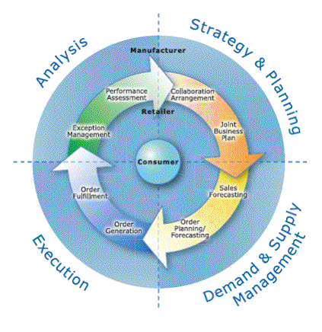
Implementing CPFR Model
Business practice which enhances the integration of supply chain system.
With the use of IT to assist and support joint practices for ex. CAO [Computer Assisted Ordering] and EDI (Electronic Data Interchange of Business information in a standardized format) helps reduce the fixed costs associated with placing each order.
Use of Web-based ordering by W.W. Grainger and McMaster-Carr has facilitated ordering in small lots because of reduced ordering costs for customers and reduced fulfillment costs for companies themselves.
By sharing information between the manufacturers, retailers and other players.

Slide 16
Managerial levers to increase profitability
Two obvious managerial levers to increase profitability are-
Increasing the salvage value of each unit increases profitability (as well as the optimal cycle service level).
Decreasing the margin lost from a stock out increases profitability (by allowing a lower optimal cycle service level). This system is followed by McMaster-Carr and W.W Grainger.
In the MRO supply industry, McMaster-Carr and W.W. Grainger, two major competitors, are also large customers for each other.

Slide 17
Tailored Transportation
Tailored transportation is the use of different transportation networks and modes based on customer and product characteristics.
Most firms sell a variety of products and serve many different customer segments.
.
W.W. Grainger sells more than 200,000 MRO supply products to both small contractors and large firms.
A firm such as W.W Grainger should design tailored transportation and not common transportation network.
Factors affecting Tailoring
Customer distance and density
Customer size
Product demand and value

Slide 18
Case Study Questions and Answers
Q.1: How many DCs should be built, and where should they be located ?
Ans:- Grainger has 33 distribution centers, if they increase the no of DC, then faster order fulfillment is possible. More DC’s should be built so that there will be more stores for one DC. McMaster-Carr uses DC as both DC and retail store; they just need to increase the no. of stores.
Q.2: How should product stocking be managed at the DCs ? Should all DCs carry all products ?
Ans: The product stocking should be according to historical data and proper forecast. DC’s should have all products and stores should have fast moving goods.

Slide 19
Case Study Questions and Answers
Q.3: What products should be carried in inventory and what products should be left with the supplier to be shipped directly in response to a customer order ?
Ans: They should use ABC analysis for inventory based on movement of goods and local demand. Supplier should be reliable so that they may deliver goods on time especially for slow moving items. Perishable items with unpredictable demands may be shipped directly.
Q.4: How should markets be allocated to DCs in terms of order fulfillment ?
Ans: The market should be allotted according to historical data, since it has been for decades in market, they must be having data. If an order cannot be fulfilled by a DC, so DC’s should be in proximity that one will act as another’s backup.

Slide 20
Suggestions for the firm to tackle Supply Challenges
To control and manage lead time variability in future.
To maintain inventory to avoid potential loss.
Use of social media data analytics in transportation.
Need of recognition of customer substitution.
Justify the involvement of third party by analyzing risk in outsourcing.

Slide 21
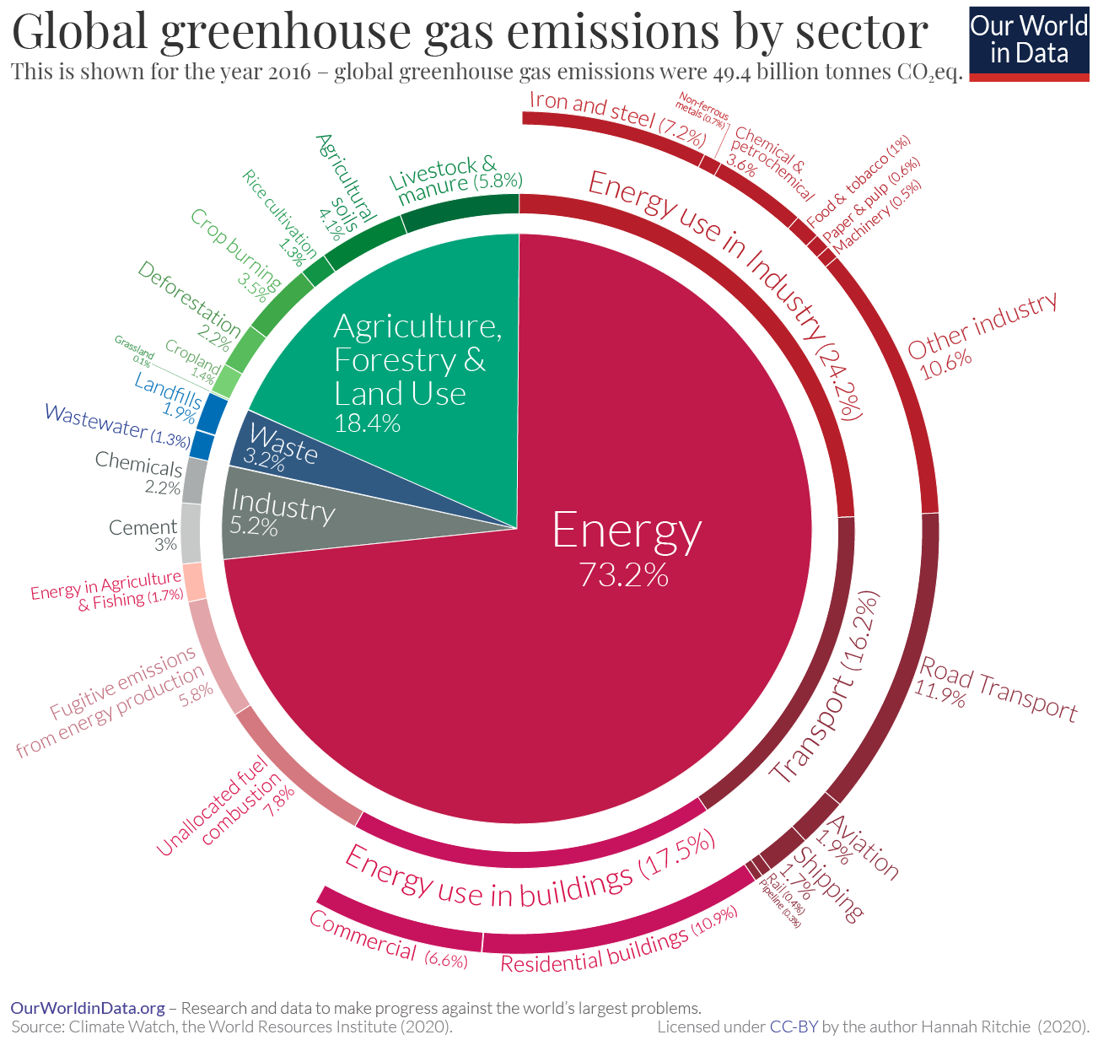
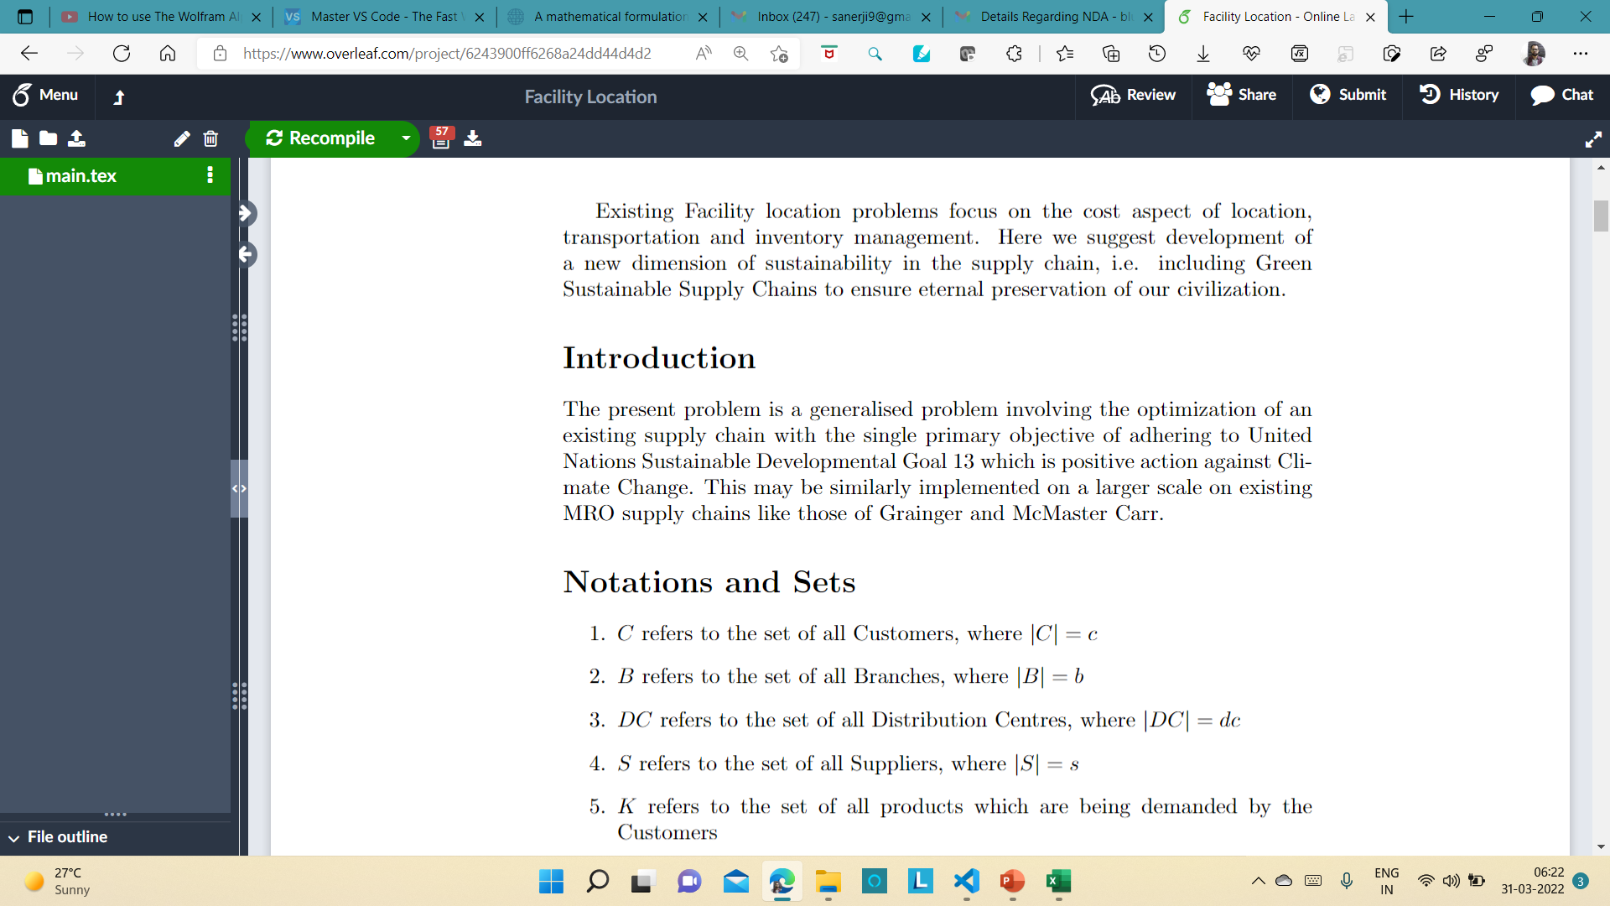
Development of Green Supply Chain by integrating existing supply chains

Slide 22
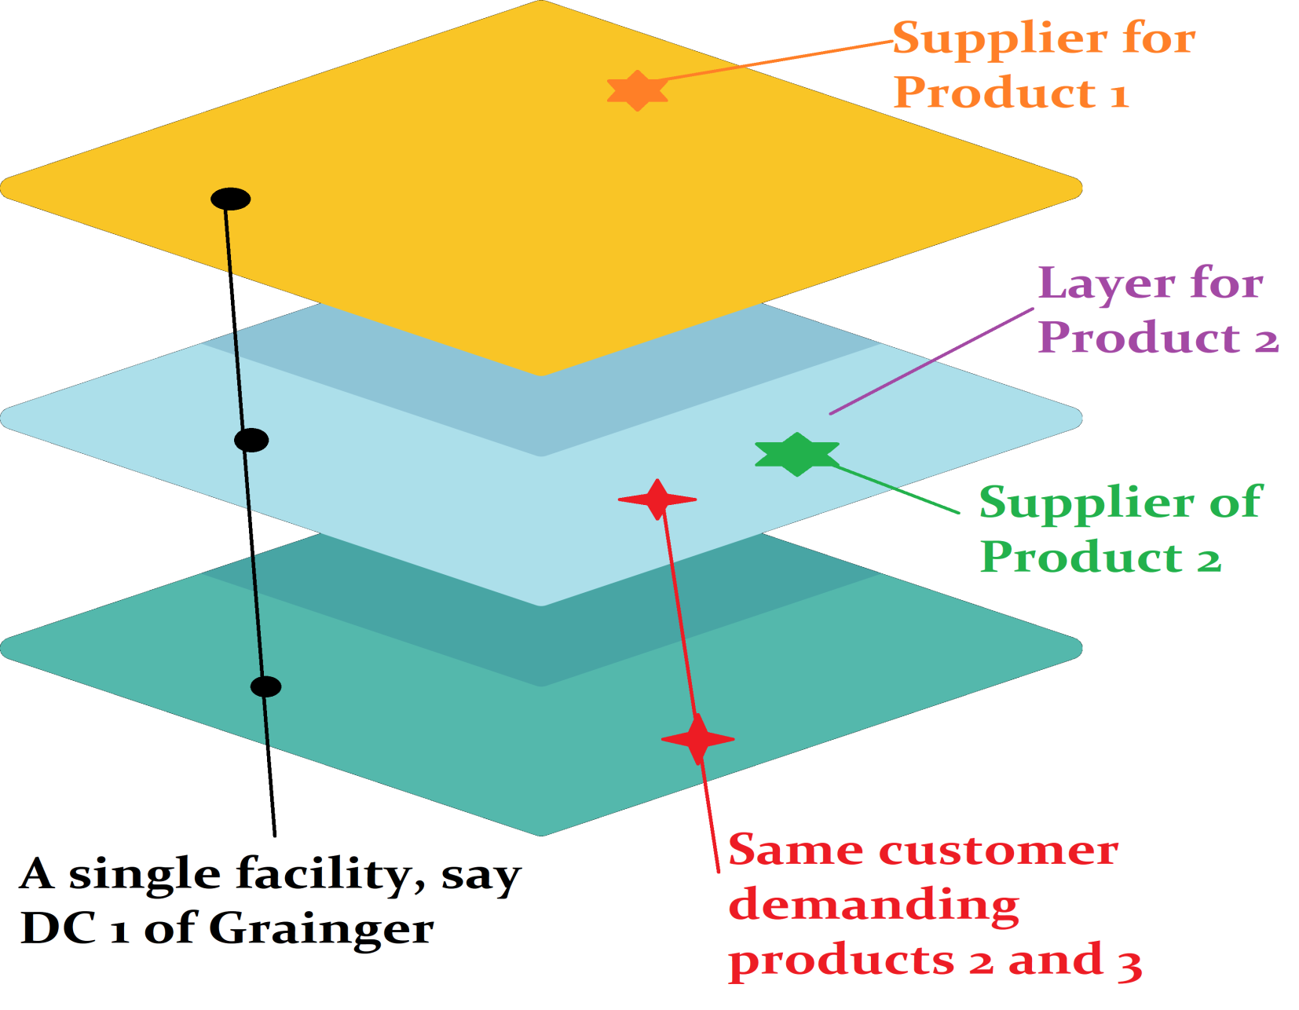
Product aggregation and integrating large supply chains for developing a Green Earth and ensuring Sustainable Development on the Kardashev Scale

Slide 23
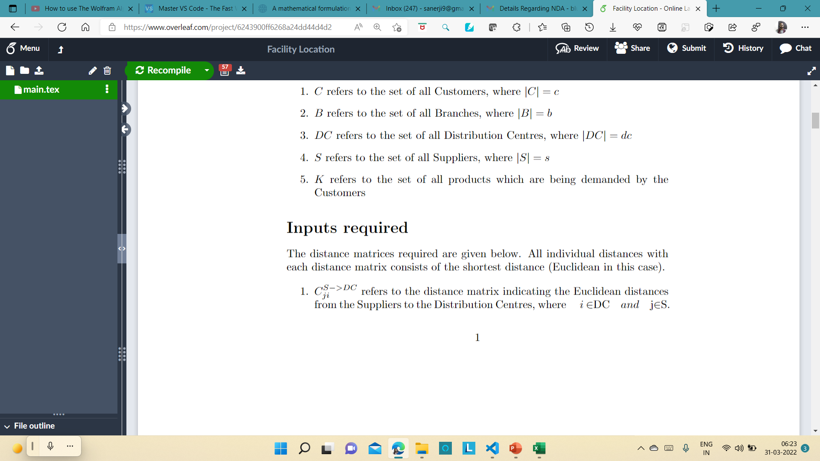
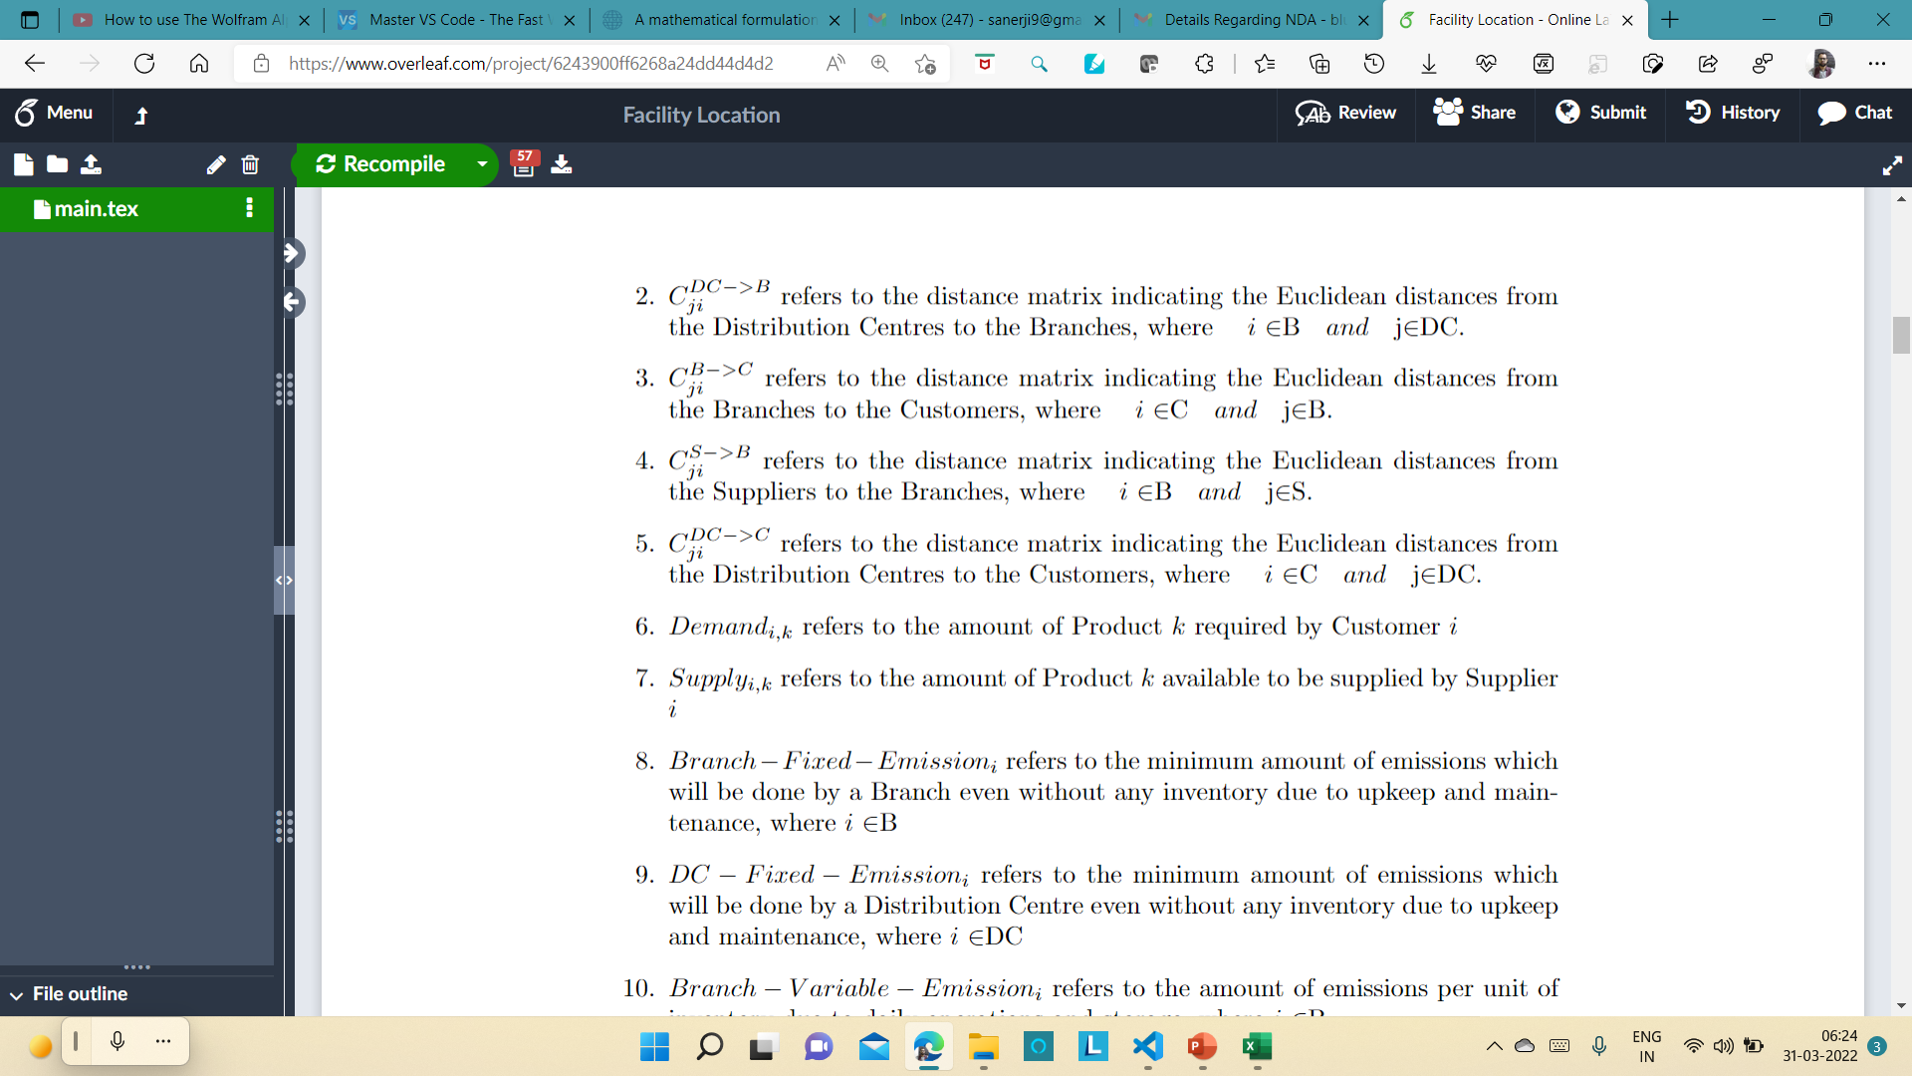


Slide 24
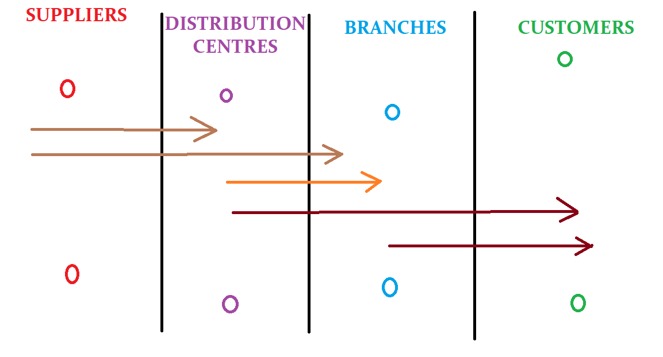
Randomly generated supply chains of both Grainger and McMaster-Carr
This case is being considered for 2 different Products
Both have 2 different Suppliers each
Both have 2 Distribution Centres each
Both Companies have 5 Branches each
Both Companies have 10 Customers each
In each case only the possible routes as shown in the figure are available. As an example, the Supplier cannot directly send shipments to customers but have to send then through the DCs or Branches.
Our main objective here is to reduce emissions due to multiple facility and multiple transportation routes available. Therefore we show improvements when merging the supply chains of the two companies together.

Slide 25


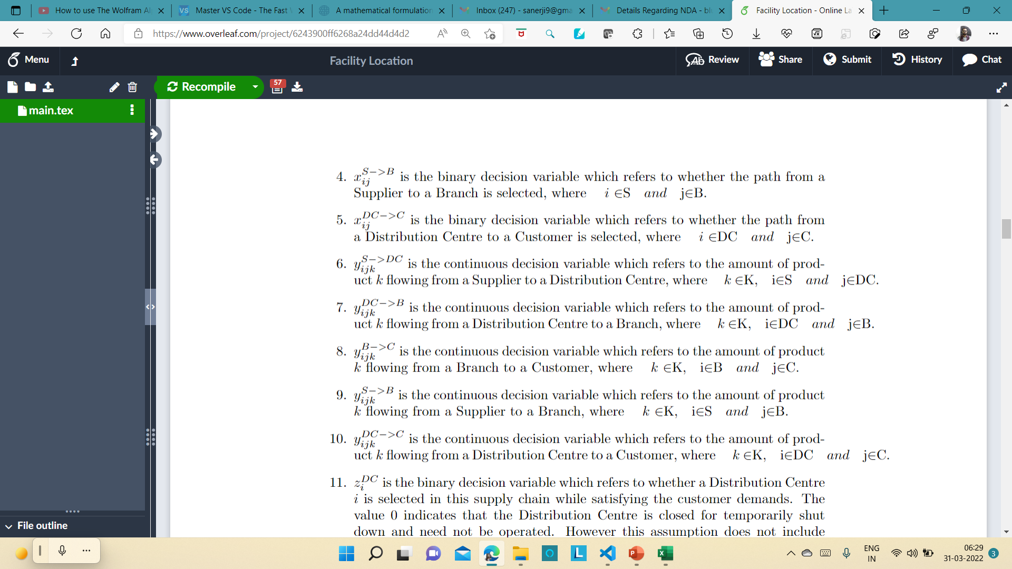

Slide 26
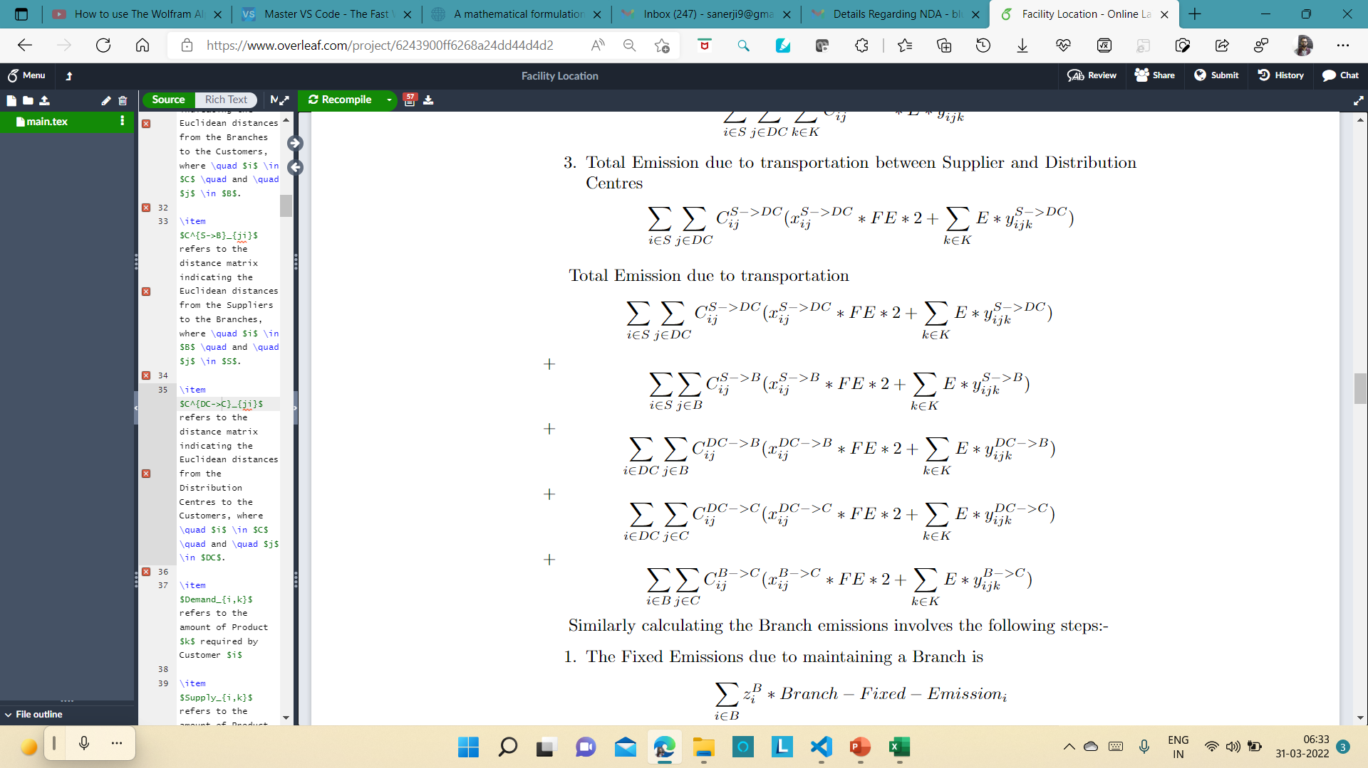
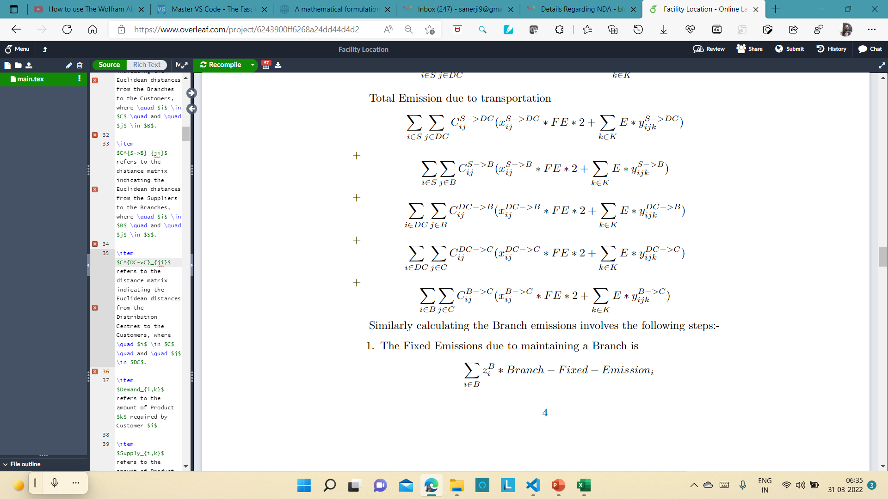
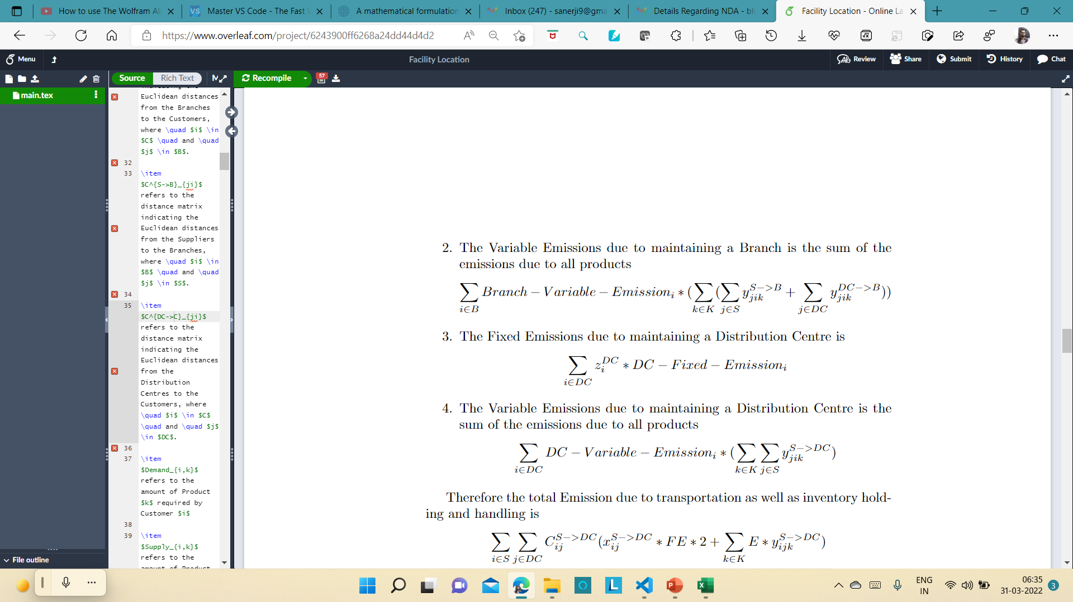
Objective Function

Slide 27
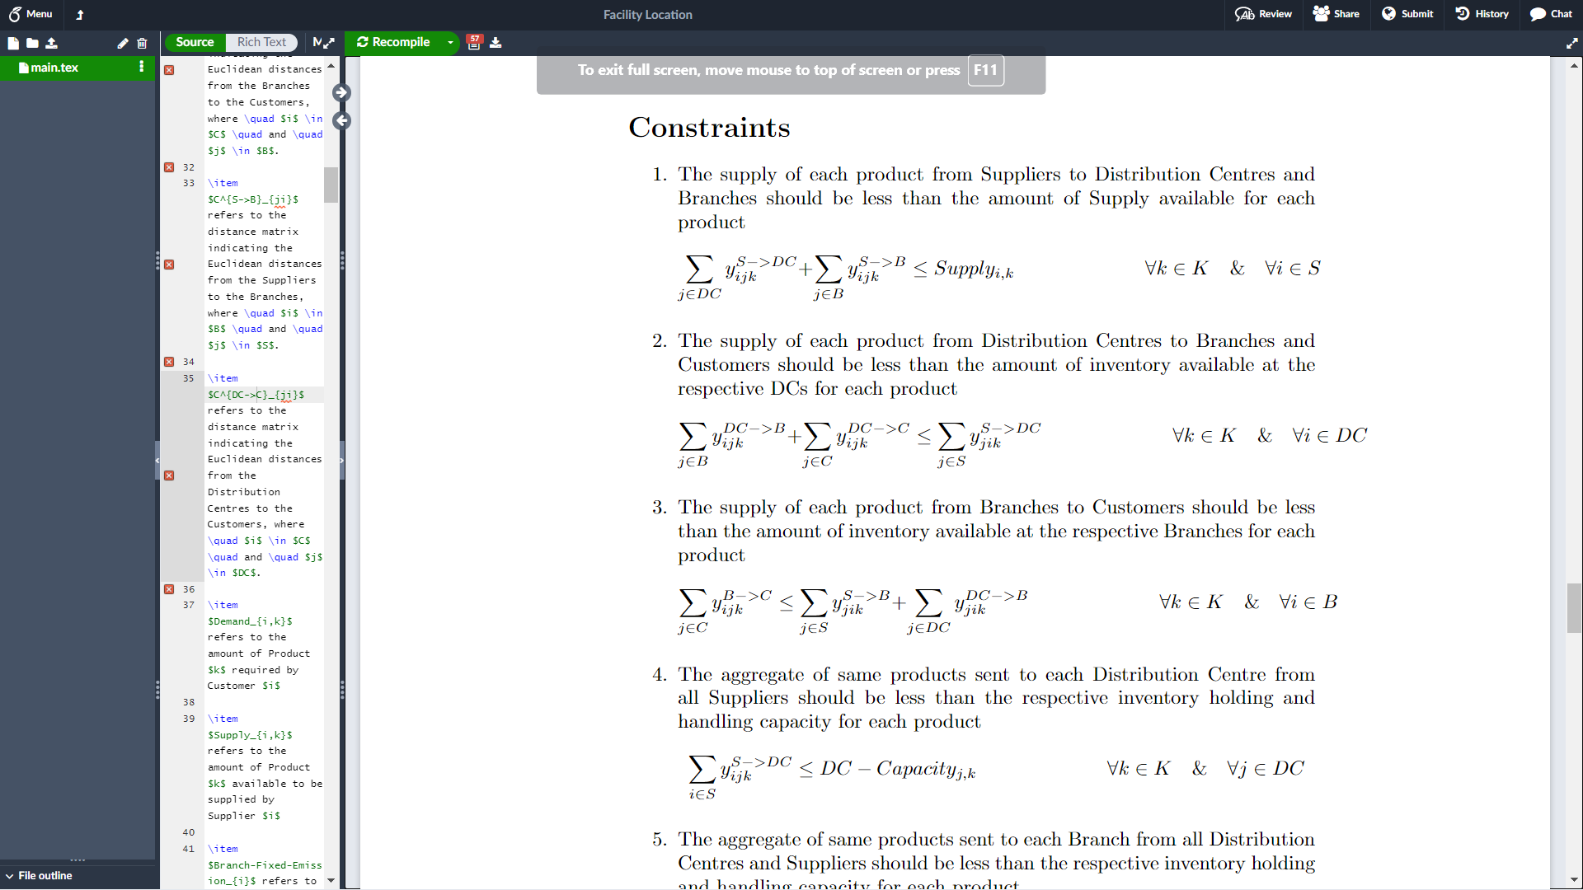
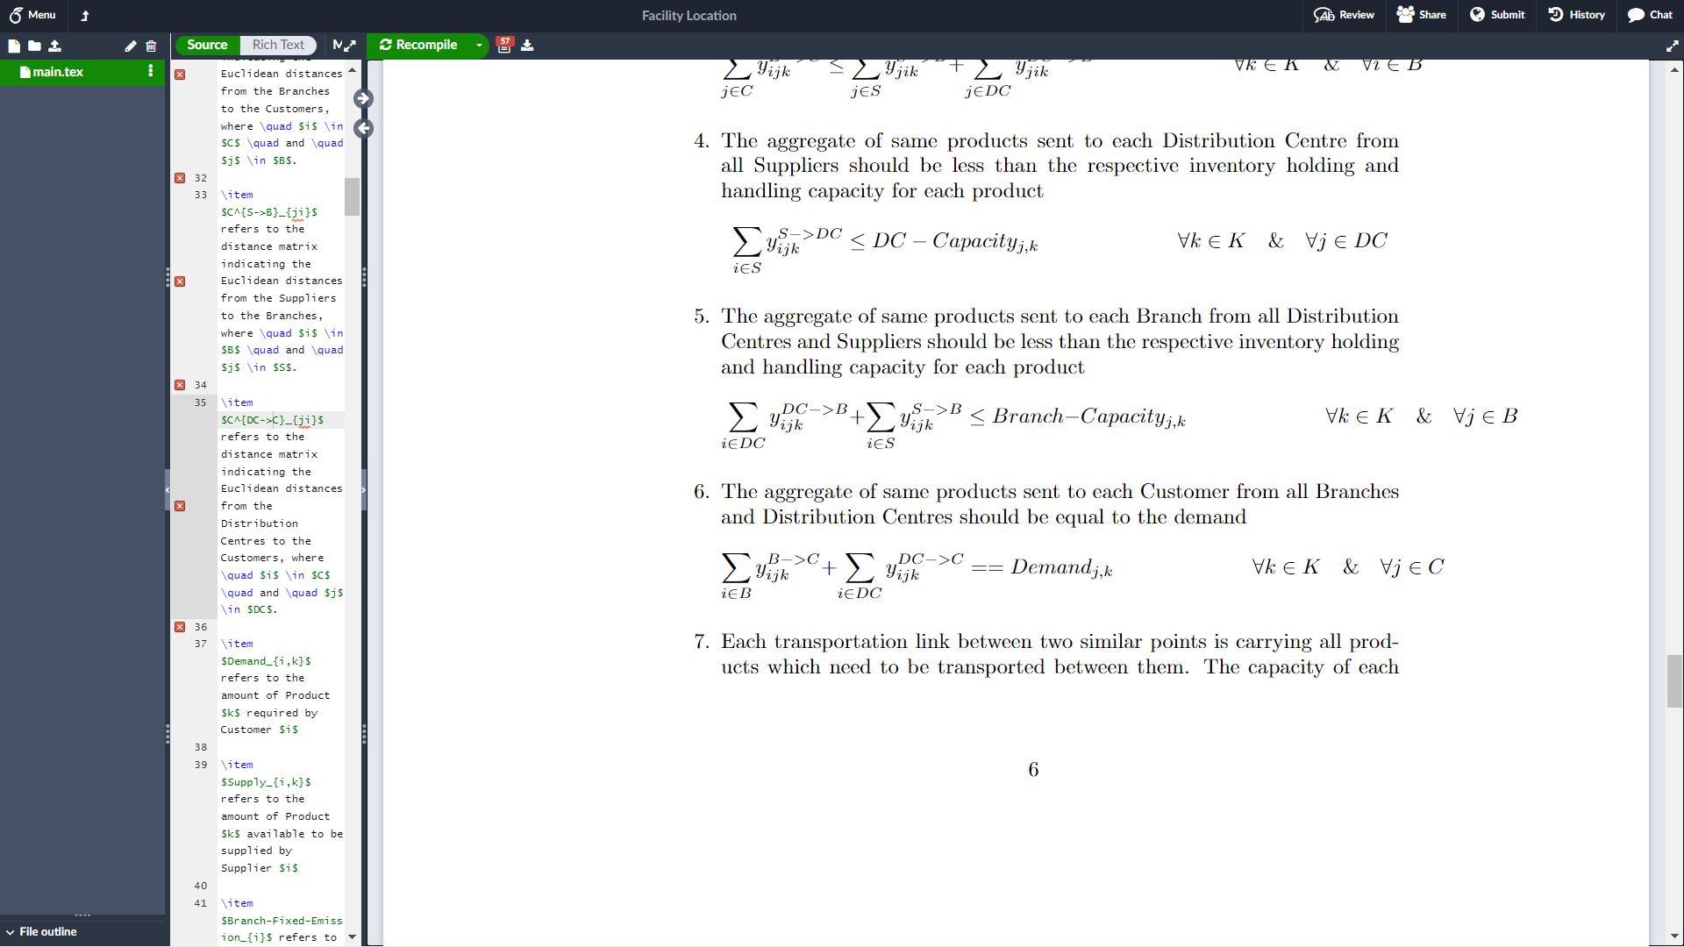
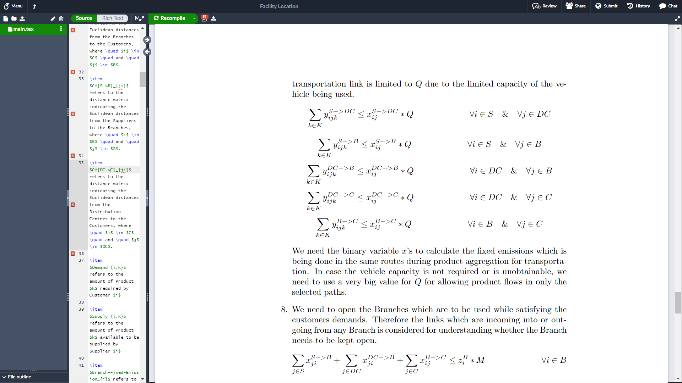

Slide 28
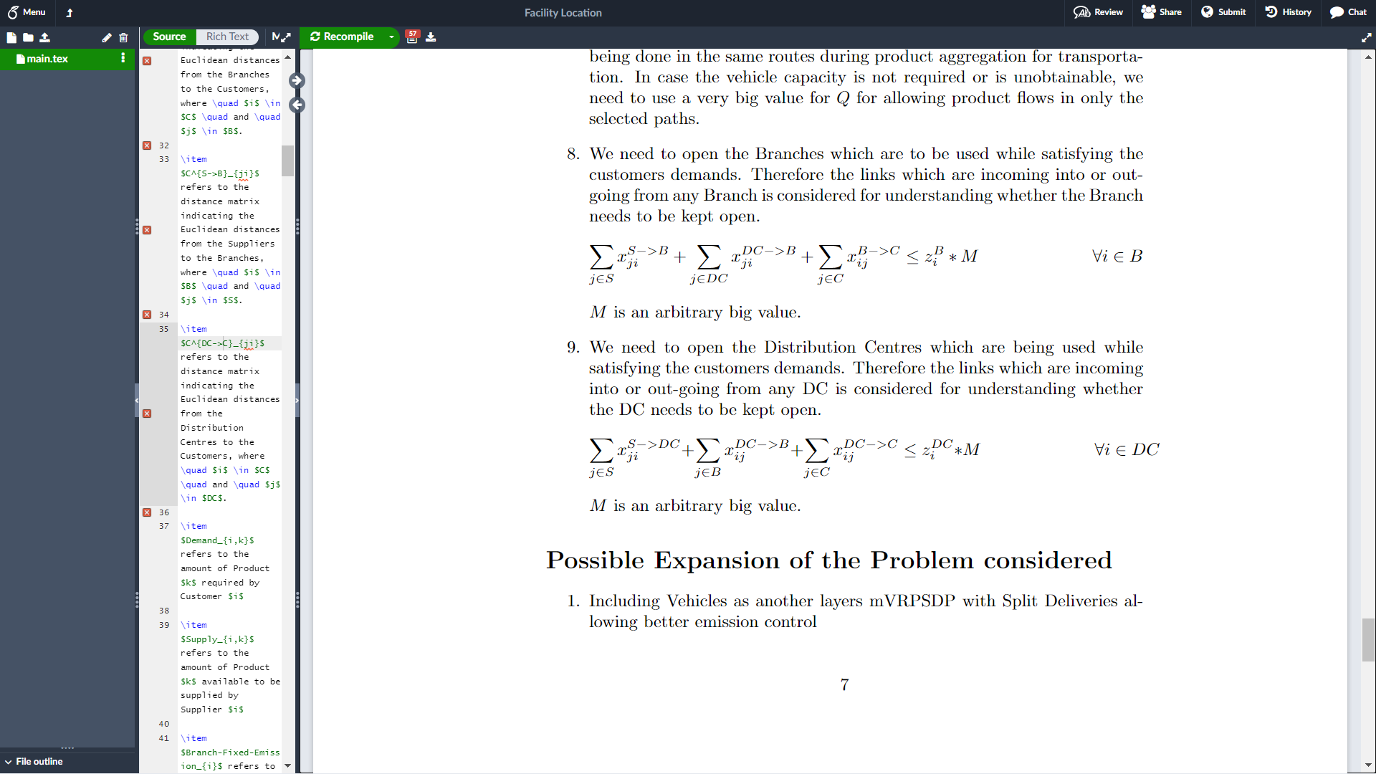
Assumptions:-
Each transport link is considered as being catered to be a Vehicle of capacity Q. This should be changed to further include a mVRPSDP also allowing Split Delivery which shall be a better formulation decreasing emission further.
The capacity constraints of the facilities are considered as if all the inventory storage and exchange happen at the same time. This is inaccurate as the capacity of each facility might not be full completely w.r.t. time which cannot be considered here.
No previous inventory has been considered.

Slide 29
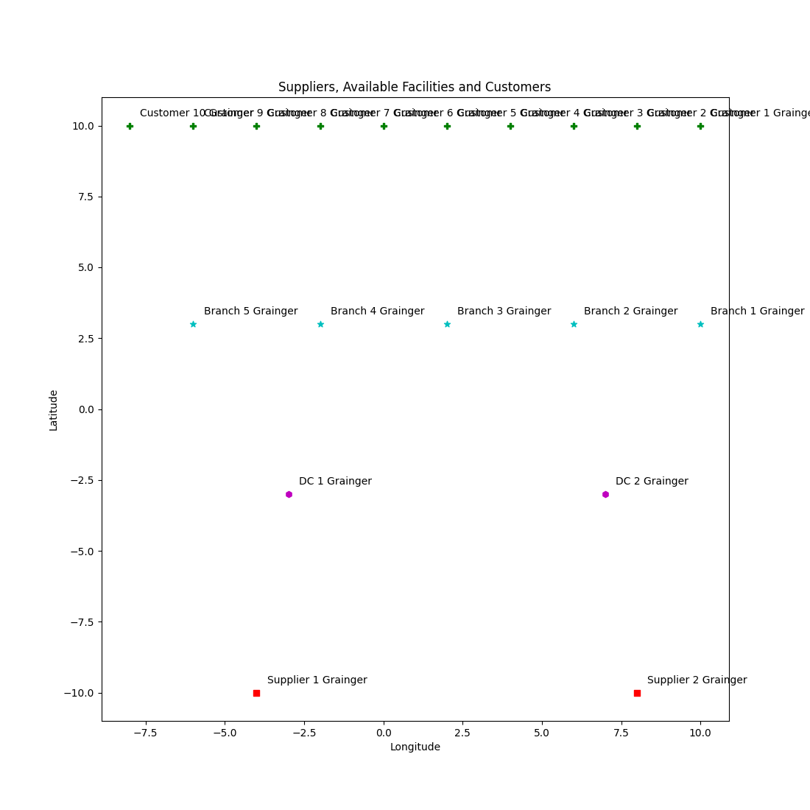
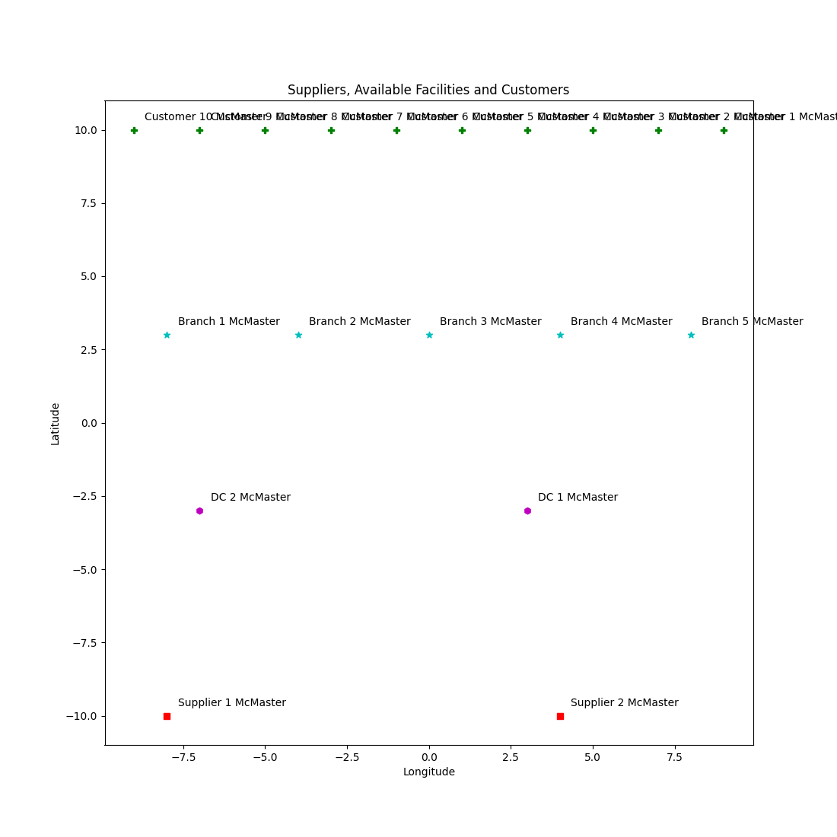
Location of Suppliers, Facilities and Customers for Grainger
Location of Suppliers, Facilities and Customers for McMaster-Carr

Slide 30
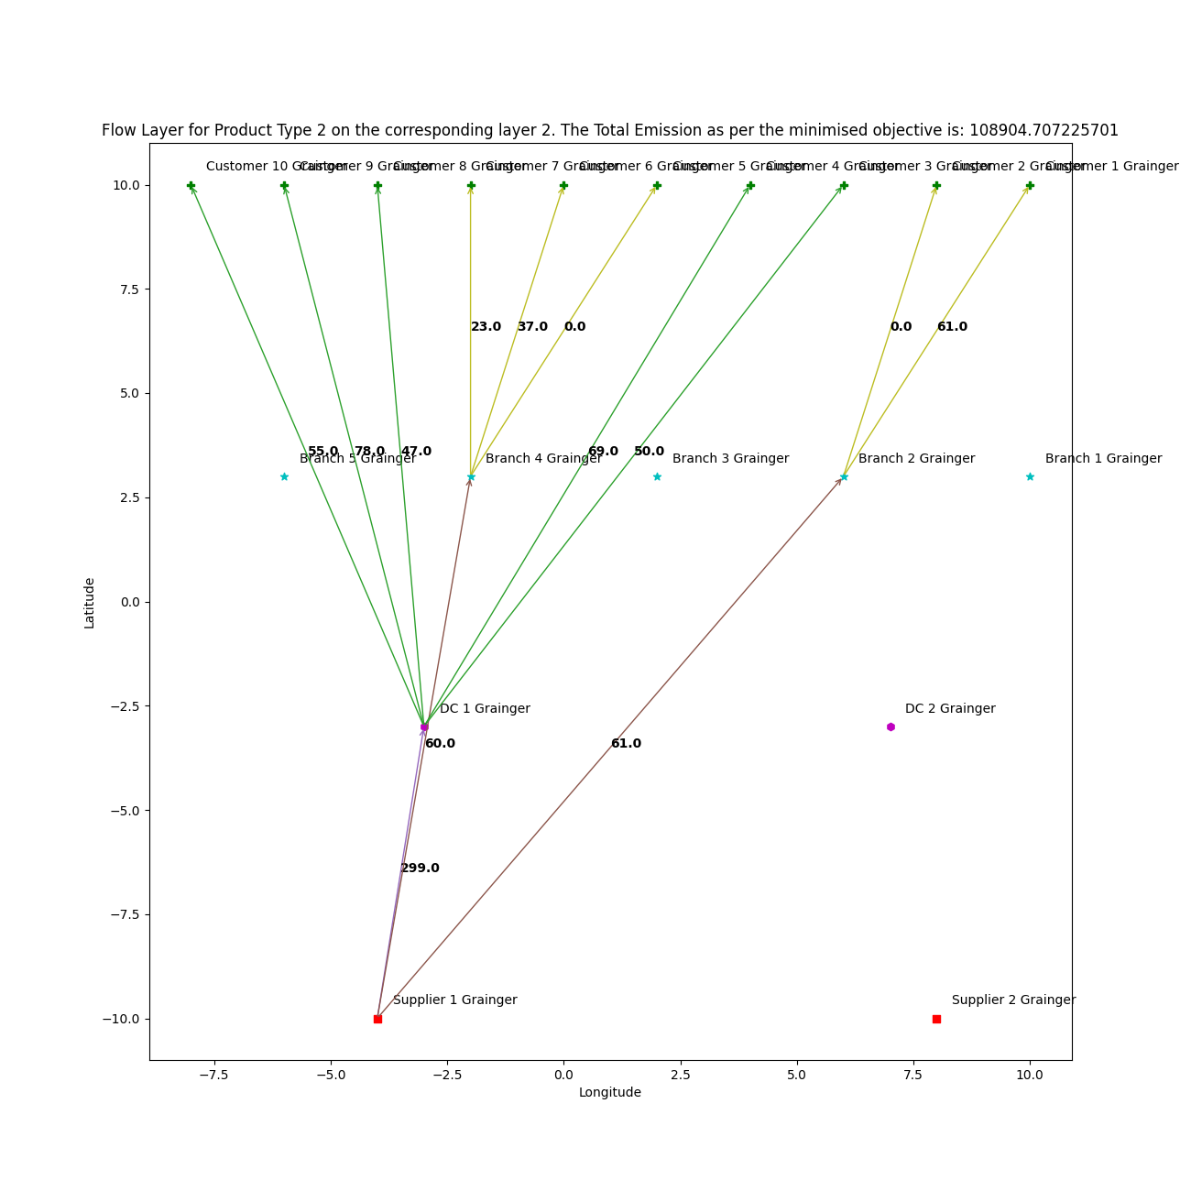

Considering Grainger’s Case:- We get the total Objective Value equal to 108904.70722570 which is the total units of emission due to this supply chain.

Slide 31
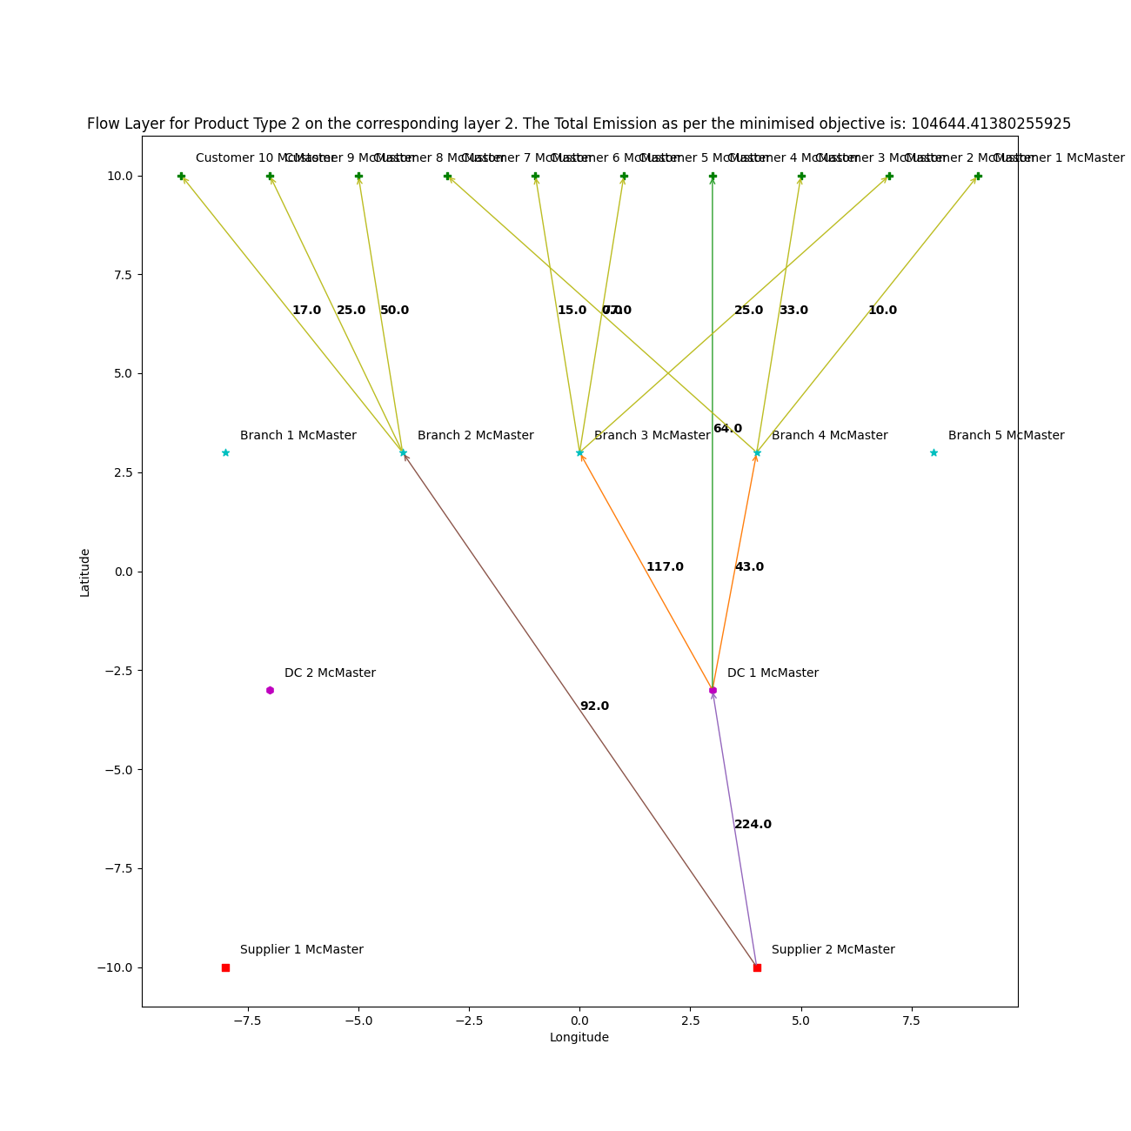
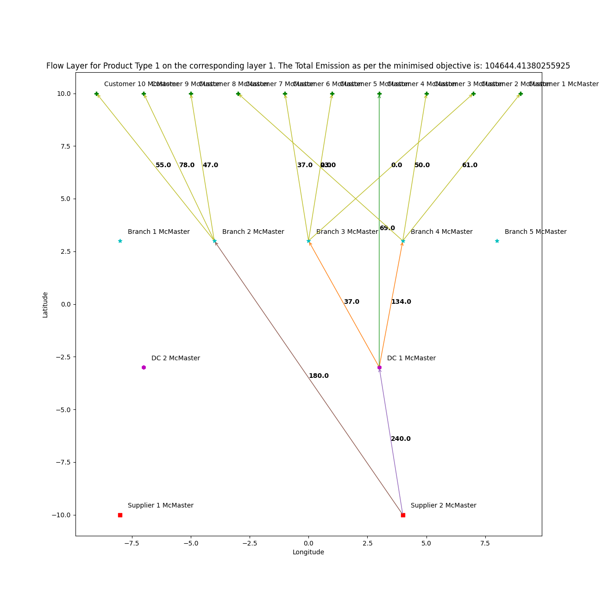
Considering McMaster-Carr’s Case:- We get the total Objective Value equal to 104644.41380256 which is the total units of emission due to this supply chain.

Slide 32
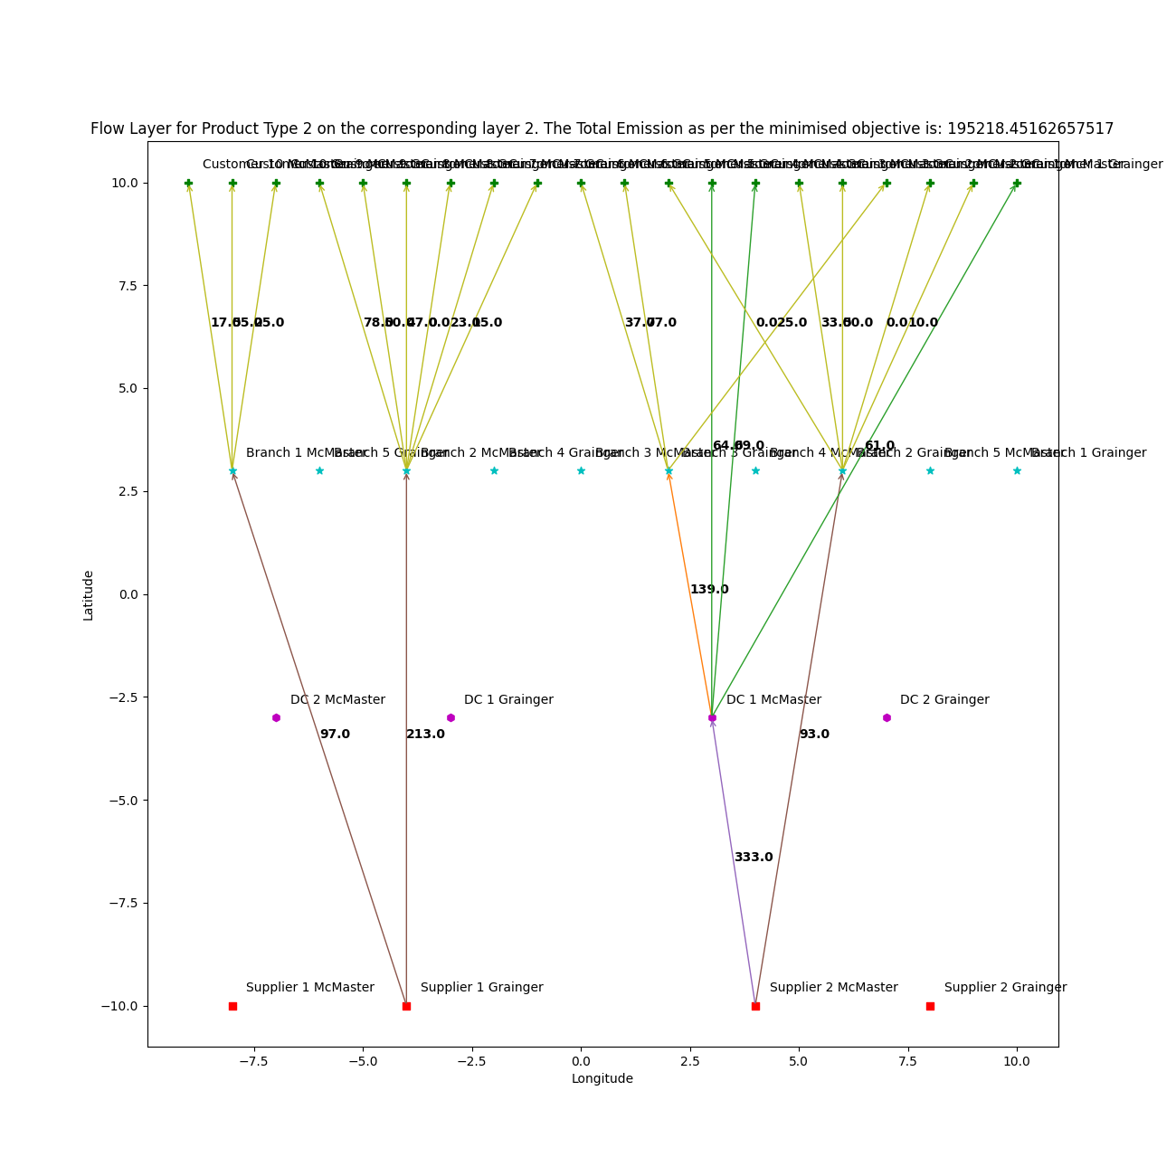
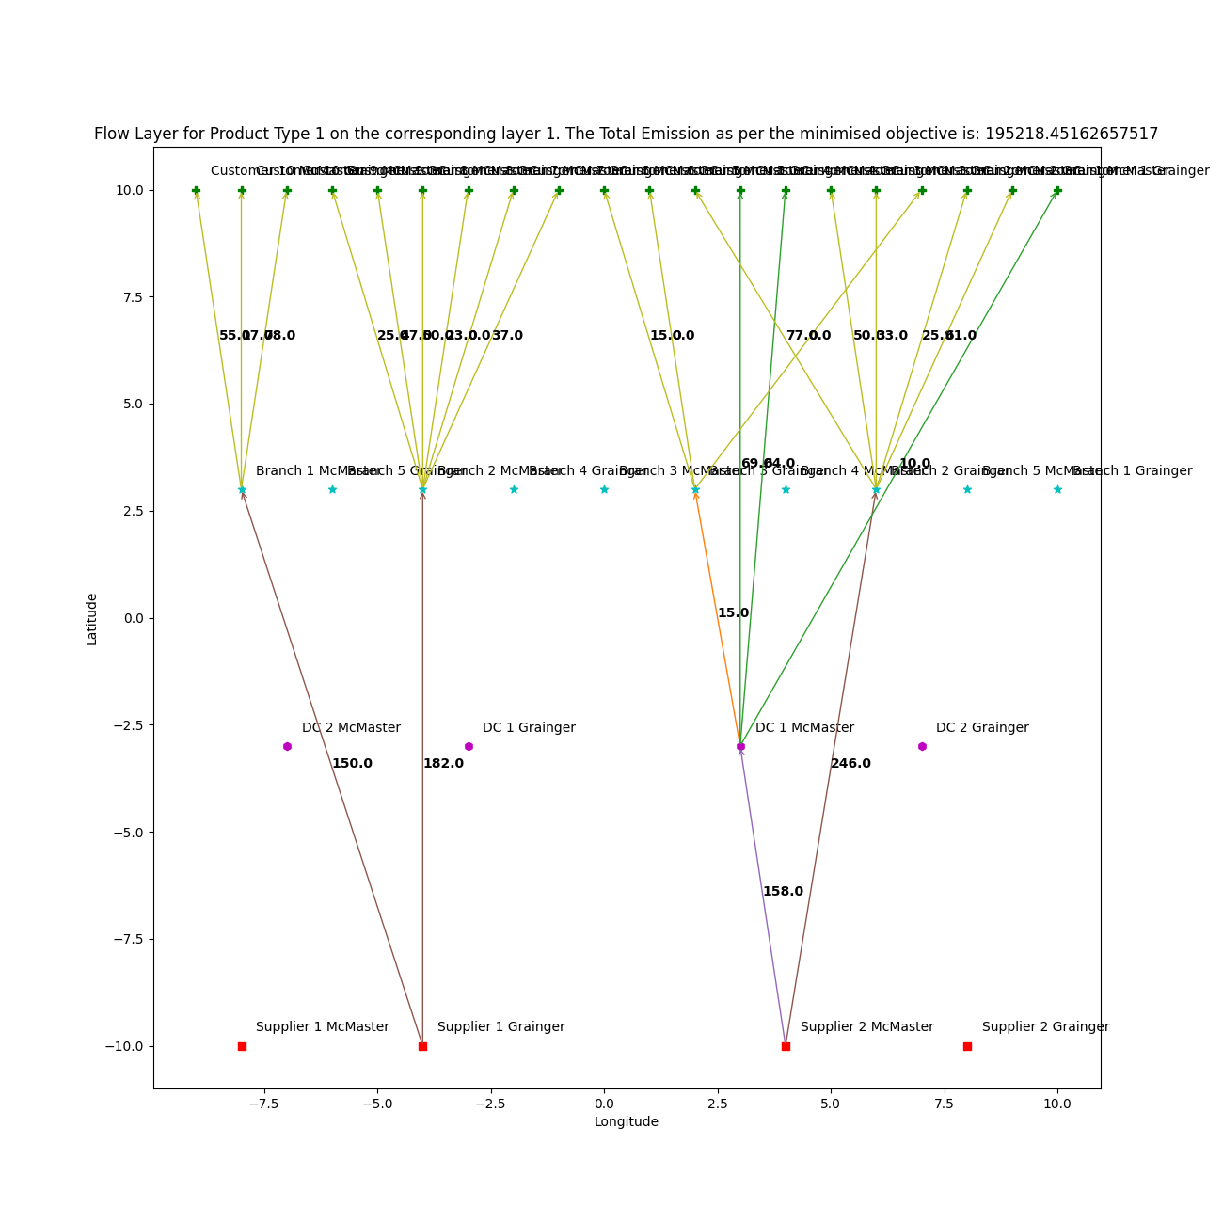
Considering the third Case:- We get the total Objective Value equal to 195218.45162658 units of emission by integrating both the supply chains which is less than the sum of their individual emissions.

Slide 33
 |  |  | Types of Supply Chain
 |  |  | Efficient | Responsive | Responsive | Green & Sustainable
Primary Goal |  |  | Lowest Cost | Quick Response | Quick Response | Lowest Emissions and least impact on future organisms of Earth, by reusing raw materials, reducing GHG emissions and generating lesser wastes
Strategy | Product Design | Product Design | Min. Product Cost | Modularity to allow postponement | Modularity to allow postponement | Including sustainable practices and innovation allowing reduced emissions as well as minimum waste generation. The generated waste after useful life cycle of the product should be biodegradable or collected back for recycling
 | Pricing | Pricing | Lower Margins | Higher Margins | Higher Margins | Existing customers are willing to pay more for sustainable products and practices
 | Manufacturing | Manufacturing | High Utilization | Capacity Flexibility | Capacity Flexibility | High utilization of intelligent manufacturing techniques including less waste generation and upcycling
 | Inventory | Inventory | Minimize Inventory | Buffer Inventory | Buffer Inventory | Green Warehouses use energy efficient lighting sources like LED lights; reduces wastes through efficient packaging using bio-degradable materials; opting for cool roofs thereby increasing cooling efficiency of the warehouse
 | Lead Time | Lead Time | Reduce but not at expense of greater cost | Aggresively reduce even if costs are significant | Aggresively reduce even if costs are significant | Reduce but not at the cost of emissions, greater waste generation or unsustainable practices
 | Supplier Selection | Supplier Selection | Cost and Low Quality | Speed, Flexibility, Quality | Speed, Flexibility, Quality | Green production channel and sustainable practices including waste management standards
 | Transportation and Distribution | Transportation and Distibution | Greater reliance on low cost modes | Greater reliance on responsive (fast) modes | Greater reliance on responsive (fast) modes | Reliance on Green Hydrogen Vehicles, Bio-Fuels, CNG, E-Vehicles for transportation thereby developing a Green Supply Chain. Developing back-channels for waste collection preventing wastes to be dumped to degrade the environment
Introducing Penalty Factors |  |  | Transitioning into Sustainable Efficient supply-chain to prevent existential crisis | Transitioning into Sustainable Responsive supply-chain to prevent existential crisis | Transitioning into Sustainable Responsive supply-chain to prevent existensial crisis | Including penalties for products and supply chains which don't follow green, clean, sustainable practices and proving government subsidies to promote eco-friendly, products, services, and supply-chains.
End-of-Life product management through Reverse Logistics |  |  | Essential to introduce and effectively integrate End-of-Life Product Management, thereby establishing services for back-propagation of wastes ensuring UpCycling and ReCycling |  |  | End-of-Life Product Management is included and should be maintained as well as scrutinized by external authorities periodically
Metrics used to measure Sustainability of Supply Chains |  |  |  |  |  | Impact on the Planet, People Engagement, Profits
 |  |  | Social, Financial and Environmental Responsibilities need to be properly addressed through innovative labour practices and CSR

Slide 34
Thank You
Department of Industrial and System Engineering

